Slide 1
Unit 3: Lesson 1 - The Need for Programming Languages
Day 17

Slide 2
Staff Sargent Smith

Slide 3
The Need for Programming Languages
Programming languages are fundamentally different from the human languages we use every day.
Programming languages are purpose-built to provide clear instructions and overcome the ambiguities of human language.
In every instance, there should be only one way to interpret a command which results in a single, repeatable outcome.

Slide 4
The Need for Programming Languages
Since programming languages are used to provide clear instructions for completing a task, they may also be thought of as the languages of algorithms.
The earliest programming languages were designed to program mechanical machines and computers, and they were typically written by punching holes in cards.

Slide 5
The Need for Programming Languages
Over time, human-readable programming languages have been developed, allowing for a more natural expression of algorithms.
Today there are hundreds of programming languages a programmer can choose from, depending on both the requirements of the task at hand and personal preference.

Slide 6
Activity
“In this class, we have already seen the word ‘algorithm’ many times. Remind me what an algorithm is and reflect on why we might want to create algorithms for a task from our daily lives.”

Slide 7
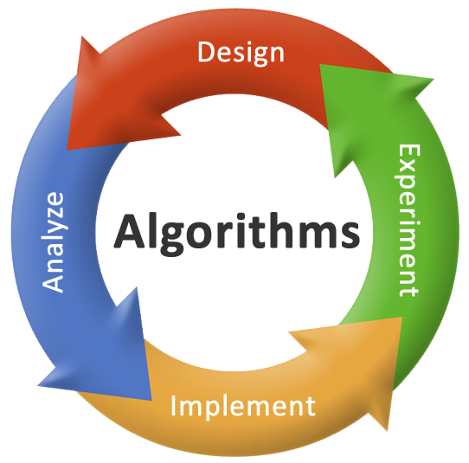
Lego Activity
An algorithm is a set of steps or instructions that can be followed to complete a task.
If we can express a task as an algorithm, then we can give those instructions to someone else (or a computer) to take care of that task for us.

Slide 8
Activity
In this class we’re going to be thinking more about creating algorithms that a computer could follow, but for now let’s focus on creating algorithms for one another.

Slide 9
Lego Activity
Create Your Arrangement: You will be given some Legos which you should connect into a single arrangement. Try to choose something interesting or challenging to test your instruction-giving abilities.
Record Your Arrangement: Take a photo W/ your phone. You’ll want an exact record, so make sure you pay attention to color!
Design Your Algorithm: On your own paper, create a set of instructions your classmates could follow to build this arrangement on their own. Your instructions may only use words, cannot use pictures.

Slide 10
Lego Activity
Test Your Algorithm: Exchange algorithms and blocks with another group and try to follow the instructions provided to create the correct arrangement. Afterwards, confirm whether you succeeded by using the other group’s image.

Slide 11
Blocks Activity
Reflection: Once you’ve had an opportunity to test one another’s instructions, respond to the following reflection questions.
Were you always able to create the intended arrangement? Were your instructions as clear as you thought?
Why do you think we are running into these miscommunications? Is it really the fault of your classmates or is something else going on?

Slide 12
Blocks Activity
Ambiguity in human language led to issues or at least difficulty in creating the arrangements.
There is a need to create a well-defined set of commands that all parties can agree upon for expressing the steps of a task, or in other words, a programming language.

Slide 13
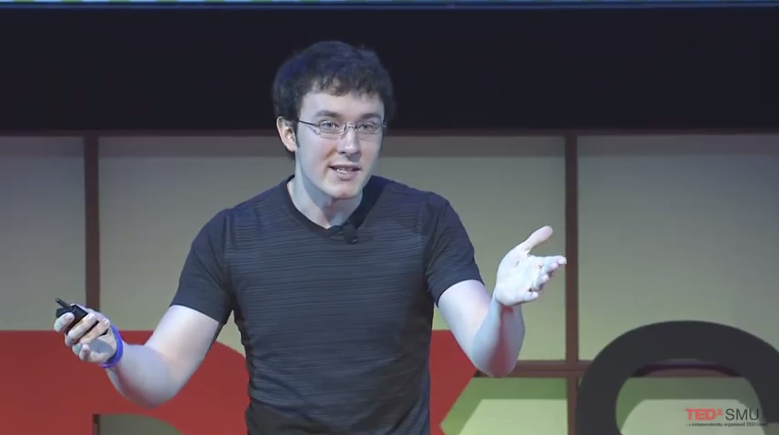
Video
Watch Video - You Should Learn to Program: Christian Genco at TEDxSMU

Slide 14
Reflection
Were you always able to create the intended arrangement? Were your instructions as clear as you thought?
Why do you think we are running into these miscommunications? Is it really the fault of your classmates or is something else going on?
Were instructions ambiguous or detail not as great as you thought?
Even when we are very careful, the very nature of human language means there is typically some room for interpretation.
In day-to-day life that’s fine, but when expressing algorithms we need to do better.

Slide 15
Next Class
Quiz next class

